Slide 1
Welcome

Slide 2

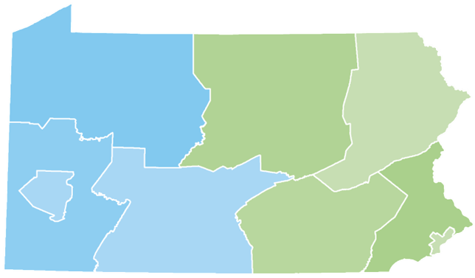
Your Presenter
Jonathan Warner
Higher Education Access Partner
PA Higher Education Assistance Agency (PHEAA)
717-678-9695
jonathan.warner@pheaa.org

Slide 3

Topics
Determining Affordability
Applying for Financial Aid
Scholarships
Financial Aid Programs
What happens after I file the FAFSA
Final Thoughts & Wrap Up
Notes:
Objectives for today is for all families/students to have a better understanding of how to:

Slide 4
Determining Affordability

Slide 5

Higher Education Choices
There are many different types of higher education opportunities to choose from including:
Colleges and Universities
Community Colleges
Hospital Schools of Nursing
Trade and Technical Schools

Slide 6

Factors in Choosing a School
Location
Size
Job Placement
Graduation Rate
Student Life
Financial Fit
Major/academic program
Safety
Acceptance of transfer credits/AP classes
Notes:
Remember to look at this factor for a number of years depending on the school type and length (2, 4, grad school)

Slide 7

Cost of Attendance
Direct Costs – What you are billed for:
Tuition
Fees
Residence hall
Meal plan
Other expenses to consider:
Books and Supplies Living Expenses Transportation

Slide 8
The Rule for Student Loan Borrowing
Don’t borrow more to get your education than you can reasonably expect to make during your very first year in the workforce.
(Recommendation from the National Endowment for Financial
Education, nefe.org)
Notes:
National average salary for a Elementary School teacher is $59,000
National Average salary for a Social worker -

Slide 9

Net Price Calculator
Provides an estimate of how much FREE Money in the form of grants and scholarships the student may be eligible for at the school based on similar student information in the previous year.
All schools are required to have a net price calculator on their website
Available on collegecost.ed.gov

Slide 10

Ways to Reduce Your Costs
Graduate on time
Research the right major
Commute
Earn college credits in high school
Start at a Community College
Check with your employer
  Google “Companies that will pay for your Education”
Notes:
Take 15 credits per semester if attending a 2 or 4 year college. Share example of what 12 credits which is full time will yield after 4 years (96 credits) when 120 credits are typically needed to graduate with a bachelors degree

Slide 11
Applying for Financial Aid

Slide 12



What is Financial Aid?
Financial aid consists of funds provided to students and families to help pay for postsecondary educational expenses.
Free Money
Grants/ Scholarships
Earned Money
Work-Study, Savings Accounts
Borrowed Money
Loans
Notes:
Paying is the joint responsibility of the student and parent(s), to the extent possible.
Not all families qualify for need-based aid. There is no guarantee that you will get any free money to pay for higher education.

Slide 13

Funding Sources
Notes:
Really comes from 4 areas –
Outside private scholarships resources – will get into more detail about these sources

Slide 14
Start with the Forms
FAFSA – Free Application for Federal Student Aid
  Required by ALL Schools, PHEAA and some scholarship organizations
  Required every year attending
STATE GRANT FORM (SGF) through PHEAA
  Required first year for all students
Some schools require additional forms:
Institutional Financial Aid Forms - through a specific school
KNOW WHAT FORMS EACH SCHOOL REQUIRES
Notes:
1st thing to determine eligibility is to apply for Financial Aid Aid – the biggest mistake families/students often make is possibly leaving free money on the table simply because they did not apply or think they would qualify for aid. There is no cost to apply
Each year, thousands of students fail to complete the FAFSA, leaving nearly $3.4 billion in financial aid unclaimed and unfortunately students who could benefit the most from financial aid are the least likely to complete the FAFSA
State Grant Info – only required your first year because we will use the FAFSA information
Will discuss these programs in more detail in upcoming slides

Slide 15

CSS Profile
College Scholarship Service Profile
Created/Maintained by the College Board
Required at some Institutions & Scholarship Organizations – 400 Across the US
Used in Addition to the FAFSA, not a Replacement
Used to Award Need Based & Institutional Aid
Also Complete the FAFSA for Federal Aid options
CSS Profile Costs $25.00 + $16.00 for Additional Schools for domestic undergraduate students whose family income is $100,001 or more – A Waiver May be Available for Domestic Students
https://www.collegeboard.org/

Slide 16
CSS PROFILE = College Scholarship Service
CSS PROFILE Schools in Pennsylvania – Domestic Students
(As of 7/7/22)
Bryn Mawr College
Bucknell University
Carnegie Mellon University
Dickinson College
Drexel University
Franklin & Marshall College
Gettysburg College
Haverford College
Kutztown University
Lafayette College
Lehigh University
Swarthmore College
Univ of Penn: Law School
Univ of Penn: Perelman Sch of Med
Univ of Pennsylvania
Univ of Pittsburgh: Sch of Med
Villanova University
https://profile.collegeboard.org/profile/ppi/participatingInstitutions.aspx

Slide 17

Know your deadlines
Federal Deadlines
Apply anytime after October 1 in the year prior to when you will attend school (2023-24: 10/1/22 to 6/30/24)
School Deadlines (CSS Profile & Institutional Applications)
vary, check with school or websites
PA State Grant Deadlines for FAFSA
May 1, 2023 - First-time and renewal students attending colleges, universities & college transferrable programs (excluding community colleges)
August 1, 2023 – First-time students attending community college; a business, trade or technical schools, hospital school of nursing; Open Admissions Institutions or a 2-year non-transferrable degree program at a Jr or 4-year college
Notes:
2nd biggest mistake students make is not meeting the application deadlie and what can be challenging is that there could be different deadlines based on the school and state.

Slide 18

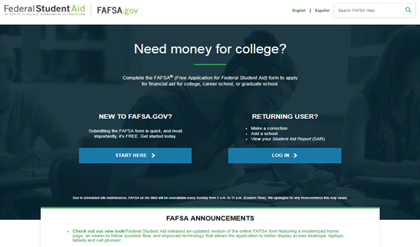
Free Application for Federal Student Aid -
FAFSA
The FAFSA is the primary federal form used to apply for financial aid
Must file a FAFSA each
year a student attends
school
File online – Fast, Secure,
SKIP LOGIC and
Built-in Edits
Studentaid.gov

Slide 19

Completing the FAFSA
Available October 1st of Student’s Senior Year –
October 1, 2022
List up to 10 schools
Don’t have to be admitted to list the school on the FAFSA
Can go back and add schools
2023-24 FAFSA will use 2021 income and tax information
Use the IRS Data Retrieval Tool (DRT)

Slide 20
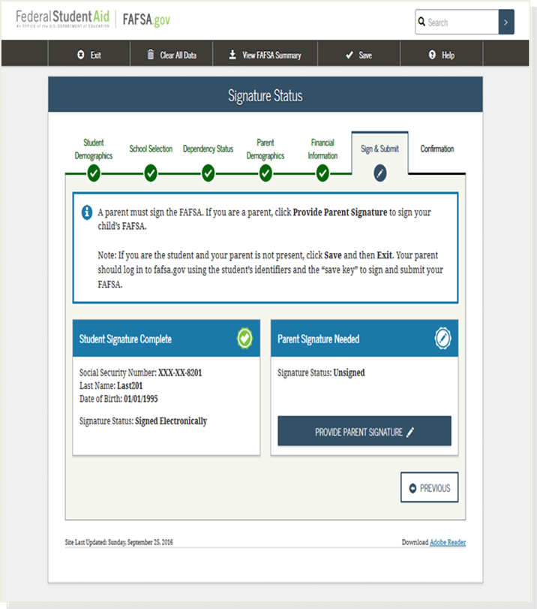

FAFSA – 7 Sections
1. Student Demographics
2. School Selection
3. Dependency Status
4. Parent Demographics
5. Financial Information
6. Sign and Submit
7. Confirmation

Slide 21
IRS Data Retrieval Tool (DRT)
Students and parents can transfer IRS tax return income directly into the FAFSA
The IRS DRT may not work if the student or parent:
  Is married and file a separate tax return from their spouses
  Married and filed as Head of Household
  FAFSA marital status doesn’t match PPY IRS tax status
  Filed a Puerto Rican or foreign tax return
  Was victim of identity theft, involving their federal tax return
  Use an address that does not match their federal tax return
Tax filers flagged due to identity theft can’t use the IRS DRT.

Slide 22
FAFSA Completion Tips

Slide 23
Create Your FSA ID Account
The student and one parent providing information on the FAFSA need to create an FSA ID account at StudentAid.gov/fsa-id
When you create the FSA ID you are creating a username and password that serves as the legal signature
Provides access to FAFSA, IRS Data Retrieval Tool and Federal Student Aid online systems
Username
Password
Social Security Number
Email Address
Mobile Number
Security Questions

Slide 24
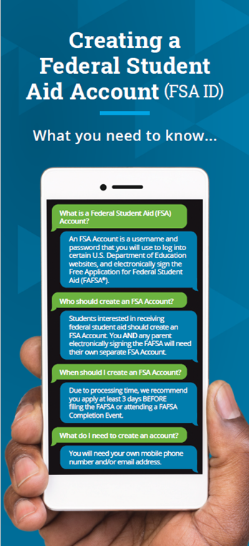
FSA ID Tips
If you are a dependent student - your parent will need an FSA ID to sign your FAFSA electronically
If the parent created an FSA ID for another child they can use the same FSA ID
You and your parent must have different FSA IDs – you cannot share email address or mobile phone number.
Notes:
You and your parent need to use your own email address and/or mobile number when creating an FSA ID ( you can’t use/share the same email address and mobile number)

Slide 25
Whose Information Goes on the FAFSA?
NO
Foster Parents
Legal Guardians
Grandparents
Anyone else the student lives with
YES
Married parents living together
Divorced or separated parents living in the same household
Biological parents (not married) living together
Divorced or separated parents
  The parent the student lived with the most over the past 12 months. If equal, then the parent who provided more than 50% of student’s financial support
Stepparents – If part of student’s household
Adoptive parents

Slide 26

When Is A Student Considered “Independent”?
Was the student born prior to
  January 1, 2000
Married
Veteran (includes active-duty personnel)
Working on graduate level degree
Emancipated minor in legal guardianship
Orphan, in foster care or ward of the court at
anytime when student was age 13 or older
Have legal dependents other than spouse
Student deemed homeless by proper authority

Slide 27

2023-2024 FAFSA Prep
Information Needed for FAFSA
Social Security Numbers – Student & Parent
Student & Parent
Federal Student Aid
Account (FSA ID)
Email Addresses
2021 Federal Income Tax Returns and ALL W-2’s – Student & Parent
Parent Current Assets
2021 Untaxed Income – Student & Parent – EXCEPT untaxed Social Security Benefits
Student Current Assets
Notes:
Untaxed income includes untaxed portion of health savings account

Slide 28
What is considered an asset?
  Current value at time of filing the FAFSA:
  Cash Stocks Certificates of Deposit
  Checking Bonds Net Value of Real Estate
  Savings Investments
  Mutual Funds 529 Plans – for all children
  Farm Value – unless primary place of residence
  Business value – Unless family owned and employs 100 employees or less
  Not reported on FAFSA
    Value of Primary home
    Value of qualified retirement accounts
    Value of life insurance policies

Slide 29
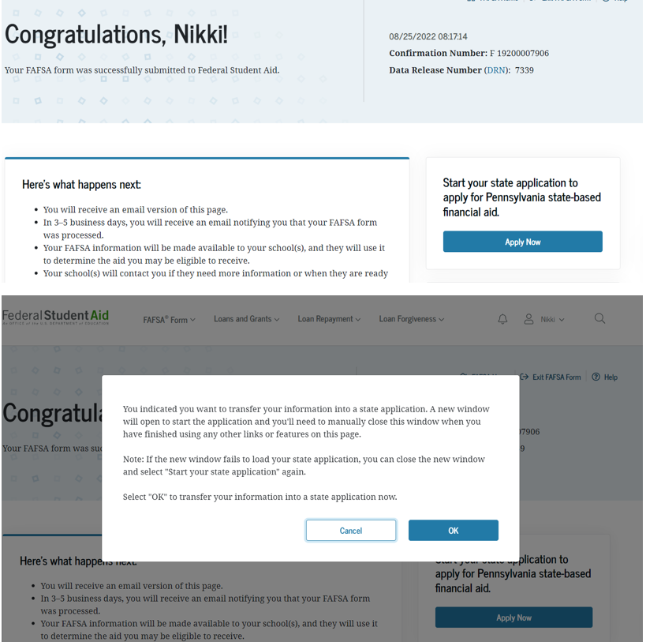

Confirmation Page & Link to the
PA State Grant Form (SGF)
Parents with multiple children who need to file the FAFSA , can click on a link to transfer their information to a different child’s FAFSA from the original child’s confirmation page.
(Look for the link)
Students residing in other states should check with their state agency to apply for aid in that state.
Notes:
Confirmation Page view

Slide 30
Special Circumstances
If your income changes after the FAFSA has been filed - contact the Financial Aid Office
  Divorced or separated parents
  Recent death or disability
  Unemployment
  Reduced income
  High Medical expenses not covered by insurance
Only a school can change a FAFSA related to special circumstances
Decisions are final and cannot be appealed to U.S. Department of Education
PA State Grant unusual circumstance consideration is separate
  Contact PHEAA and complete appropriate forms PHEAA.org/forms

Slide 31
Scholarships

Slide 32

Searching for Scholarships
Postsecondary Schools
Local and Regional
National

Slide 33
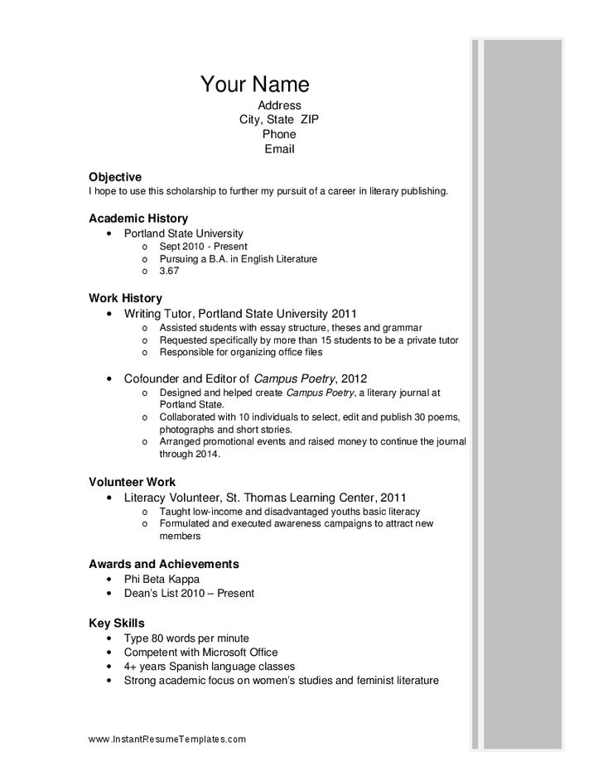
Increase Your Scholarship Opportunities
Create a Resume
  Academics – Honor/AP courses, grades, GPA, class rank, test scores
  Personal / Performance – sports, music, art, leadership, achievements
  Extra Curricular Activities – jobs, hobbies
  Volunteerism, Community Activities, Employment
What makes you stand out?
  Besides grades, class rank , test scores
Recommendations
  Teachers, Advisors, Mentors, Coaches, Employers, Community Leaders
Notes:
You will want to Organize your important information about yourself to increase your chances of obtaining scholarships
One way is to Create a scholarship resume and use this to complete scholarship applications. Include things such as – achievements, leadership positions, extracurricular activities, community service and volunteerism, employment

Slide 34


Slide 35

Begin Searching Early
Fastweb.com
Collegeboard.org
Scholarshipamerica.org
GoingMerry.com
Notes:
These are some National Websites to search for scholarships. With these sites students will create a profile – answer questions about themselves and their parents and are then matched with specific scholarships that would be a good fit to apply for. These sites are free to use.
Remember that you never want to pay to someone or a company to do a scholarship search for you. They usually take your money and you never hear from them again. There are many free resources and sites that you can search on your own.

Slide 36

Scholarship Opportunities
Mike Rowe Works Foundation
Live Mas Scholarship –Taco Bell
Cameron Impact Scholarship
Equitable Excellence Scholarship
Coca Cola Scholars
QuestBridge
College Board Opportunity Scholarships
Doodle4Google
Stuck at Prom – Duct Tape
Horatio Alger Association Scholarship
Notes:
Mike Rowe - This program doesn’t focus on test scores, grades, or grammar. It’s about the people who share our values and understand the importance of work ethic, personal responsibility, delayed gratification, and a positive attitude. Mike Rowe is the person at was on the dirty jobs show

Slide 37

Scholarship Search Tips
Begin Searching Early – you don’t have to be a senior to search for scholarships
Don’t ignore scholarships with smaller award amounts
Write an essay that makes a strong impression
Search for scholarships every year
Watch for Scholarship Scams
Don’t Miss Deadlines
Notes:
Begin searching early for scholarships – many scholarship deadlines are early during the senior year of.
Sort your applications by due date and do them in the order they’re due; but keep in mind that some require more work (letters of recommendation, a longer essay, etc.) and may take more time.
Use a professional email address, such as firstname.lastname@gmail.com
Clean up the content of your Facebook account, removing inappropriate and immature material
Google your name to see what shows up

Slide 38


Advice from Graduating Seniors
Teacher recommendations mean a lot. Your essay is probably the biggest thing they’re going to look at.
It takes a great deal of dedication, but it is so worth it in the end!
Start early and look around locally.
Even if it's a lengthy application, take the time and fill it out. Chances are that other people think it's too long and won't take the time to do it themselves.

Slide 39
Financial Aid Programs

Slide 40
Pennsylvania State Grant
Based on Financial Need
Must be enrolled in a program that is at least 2 years in length
Enrolled at a PHEAA approved school
Award amount determined from information on the FAFSA and in part by the cost of the school

Slide 41
2022-23 Award Amounts
Cost Tier | Maximum Award | Minimum Award
$0 - $12,000 | $3,059 | $500
$12,001 - $19,000 | $4,894 | $500
$19,001 - $29,000 | $5,261 | $500
$29,001 - $32,000 | $5,750 | $500

Slide 42
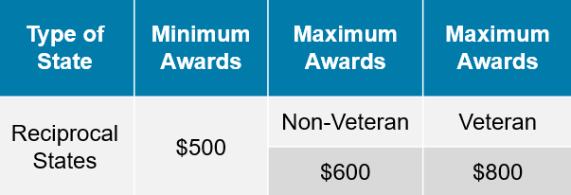

2022-23 Out-of-State Awards
Reciprocal States
Delaware Massachusetts
West Virginia District of Columbia Ohio Vermont
EXCEPTION: Allegany College of Maryland – PA campus Eligible for PA State Grant

Slide 43
Other State Programs
State Work-Study
Blind or Deaf Beneficiary Grant
Educational Assistance Grant (EAP) – National Guard
Chafee Education and Training Grant – co-administered with the PA Department of Human Services
Fostering Independence Tuition Education Waiver
Pennsylvania National Guard Military Family Education Program (MFEP)
Postsecondary Educational Gratuity Program (PEGP)
Ready to Succeed Scholarship (RTSS)
Partnerships for Access to Higher Education (PATH)
Pennsylvania Targeted Industry Program (PA –TIP)
For details, visit www.pheaa.org

Slide 44
PA Targeted Industry Program (PA-TIP)
Targeted industries at approved schools:
  Health
  Energy
  Advanced Materials and Diversified Manufacturing
  Agriculture and Food Production
Maximum award is the lesser of:
  Maximum annual PA-TIP award of $5,000 or
  Student’s approved program costs minus gift and employer aid
Many requirements of PA State Grant, except:
  Program must be at least 10 weeks but less than 2 years
Must file FAFSA every year
Must file PA–TIP application (1st-time applicants only)

Slide 45
Federal Grants
Federal Pell Grant
  Based on financial need
  2022-23 max award - $6,895
Federal Supplemental Educational Opportunity Grant (FSEOG)
  Based on financial need
  Must be Pell Grant eligible
  Max award $4,000
Notes:
Pell Grant eligibility efc 0 - 5846

Slide 46
Other Federal Programs
Teacher Education Assistance for College & Higher Education Grant (TEACH)
  Students who plan to teach in a high-need field at the secondary level
  Minimum service commitment
  More information at StudentAid.gov
Iraq and Afghanistan Service Grant
  Students whose parent passed away performing military service in Afghanistan or Iraq war
  More information at StudentAid.gov
AmeriCorps
  Perform community service in exchange for education award
  Award can cover range of educational expenses
  More information at Nationalservice.gov

Slide 47

Federal Work Study
Based on financial need
Must work to receive a paycheck
Work Study award is not deducted from the student’s bill
Answer “Yes” to question on the FAFSA
Earnings do not count as student income on FAFSA

Slide 48
Federal Loans

Slide 49

Federal Direct Student Loans
In the student’s name
No credit check
No co-signer required
Fixed interest rate of 4.99% and 1.057%
origination fee (processing fee)
Rate for new loans reset every July
6 month grace period
Subsidized or Unsubsidized
10 year standard repayment plan but other options available
Apply at www.studentaid.gov

Slide 50
Subsidized
Unsubsidized
Federal Government pays interest charged to student while enrolled or in grace
Based on financial need
There is a 1.057%
fee deducted from
loan amount at disbursement
Borrower is responsible for paying interest accrued in school and grace
Any interest not paid during grace will be capitalized at repayment
There is a 1.057%
fee deducted from
loan amount at disbursement

Slide 51
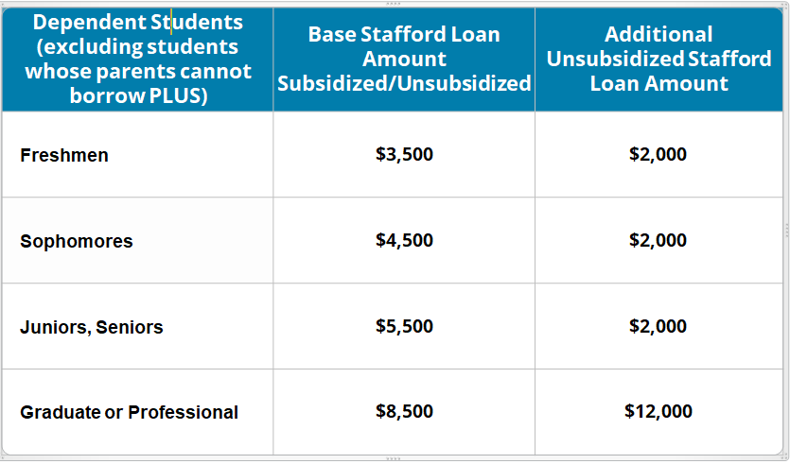
Student Loan Borrowing Limits

Slide 52
What if I need to borrow more than $5,500 to cover my bill?

Slide 53
Federal Loan
Federal Direct Parent PLUS Loan
Parent is the borrower and the loan remains in parent’s name
Credit check is required - Can have a co-signer
Interest/Fees: 7.54% interest rate and 4.228% origination fee
Cost minus financial aid received (maximum amount you can borrow)
Repayment begins 60 days after disbursement
  Parent can choose to defer payments while student is enrolled
Apply at www.studentaid.gov

Slide 54
Private/Alternative Loans

Slide 55
!
ONLY consider private or alternative loans after looking into all other sources of financial aid.

Slide 56
Private/Alternative Loans
From private lenders or financial institutions
  In student’s name/co-signers usually required or Parent Private Loan
  Can borrow up to the Cost of Attendance
  Based on credit scores and debt-to-income
  Repayment may be deferred until education completed
  Terms vary by lender – compare before making choices
READ THE FINE PRINT

Slide 57

PA’s Low-Cost Way
to Pay for College!
Low, Fixed Rates
3.82-7.69%
1,2,3
^{APR}
Effective as of 6/8/22
Learn more at PHEAA.org/PAForward
1) Annual Percentage Rate (APR) Calculations - The lowest APR is based on the following assumptions: a loan of $10,000 made in a single disbursement, a borrower who selected an Immediate Repayment Plan and a repayment term of 60 months, monthly payments of $183.49 and a final payment $175.40, a fixed periodic interest rate of 4.10%, and a total amount financed of $11,001.26. The borrower in this sample qualified for a 0.25% Direct Debit benefit for the entirety of the repayment period and a 0.50% graduation benefit was applied 47 months into repayment.
The highest APR is based on the following assumptions: a loan of $10,000 made in a single disbursement, a borrower who selected a Fully Deferred Repayment Plan and a repayment term of 180 months, monthly payments of $131.09, a fixed periodic interest rate of 8.20%, and a total amount financed of $23,596.64. The borrower received an in-school deferment of 46 months and a grace period of 6 months. The borrower in this sample did not qualify for any interest rate discounts.
These APRs are estimates and may differ from the actual rates received.
2) Subject to aggregate loan limits.
3) Loans taken for a less than half-time academic period may borrow up to $5,000. Applicants are subject to credit qualifications, completion of an application and credit agreement, and verification of application information. PHEAA uses applicant(s) FICO score(s) to determine eligibility and interest rates. Higher credit scores may mean an applicant is offered a lower interest rate.
PHEAA reserves the right to discontinue all programs or benefits without prior notice.
Notes:
Loan Types:
Undergraduate
Graduate
Parent, Stepparent, Guardian
Refinance
Features:
Low, fixed rates
No fees
Borrower benefits (0.25% ACH, 0.50% Graduation)
Multiple repayment options
Co-signer release option
No-pre-payment penalty
Deferment & forbearance options

Slide 58
FAFSA’s filed – what’s next

Slide 59
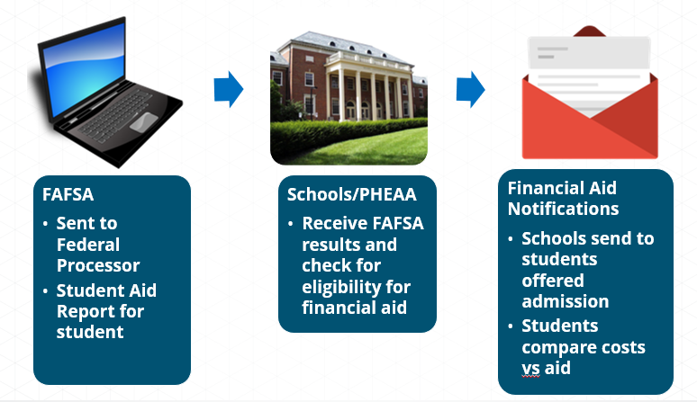
What happens after the FAFSA is Filed?

Slide 60

Expected Family Contribution - EFC
The Federal Processor uses a federal formula to determine the Expected Family Contribution (EFC)
Schools use the EFC to determine eligibility for financial aid
Remains the same no matter which school the student attends
The EFC can be found on the FAFSA Confirmation Page
Expected Family Contribution (EFC) is determined based on:
  Parent income and assets
  Student income and assets
  Family size
  Number in college
  Age of the older parent
Notes:
Your EFC is an index number that college financial aid staff use to determine how much financial aid you would receive if you were to attend their school. The information you report on your FAFSA form is used to calculate your EFC.
The EFC is calculated according to a formula established by law. Your family's taxed and untaxed income, assets, and benefits (such as unemployment or Social Security) all could be considered in the formula. Also considered are your family size and the number of family members who will attend college or career school during the year. The EFC Formula guide shows exactly how an EFC is calculated.
Your EFC is not the amount of money your family will have to pay for college, nor is it the amount of federal student aid you will receive. It is a number used by your school to calculate how much financial aid you are eligible to receive.

Slide 61
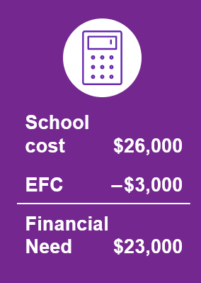
Calculating Financial Need
Schools/colleges receive financial aid information from the FAFSA and calculate financial need
Financial Aid Office (FAO) “awards” the student based on financial need and available funding (varies from school to school)
Financial aid offer is sent to student once accepted at the the school

Slide 62
Reviewing the Financial Aid Notification
After reviewing your notifications, students should be sure they know and understand the following:
How much of the financial aid is free money?
If receiving outside scholarship(s), will it change your financial aid from the school?
Are there any conditions on the free money? GPA requirement?
Will financial aid increase as tuition increases?
Will eligibility change from year to year?
Will loans be needed?
Notes:
As you review the Financial Aid notification these are some questions that you may have.
Which types of aid are based on need, and which are based on merit?
The answers to these questions may be provided in with the Financial aid notification, if they are not and if you have additional questions
you will want to contact the Financial aid at the school.
The financial aid that is awarded may NOT meet or cover all of your calculated expenses or costs at the school
Be sure to determine how much will be required of you in out-of-pocket costs and loans.

Slide 63
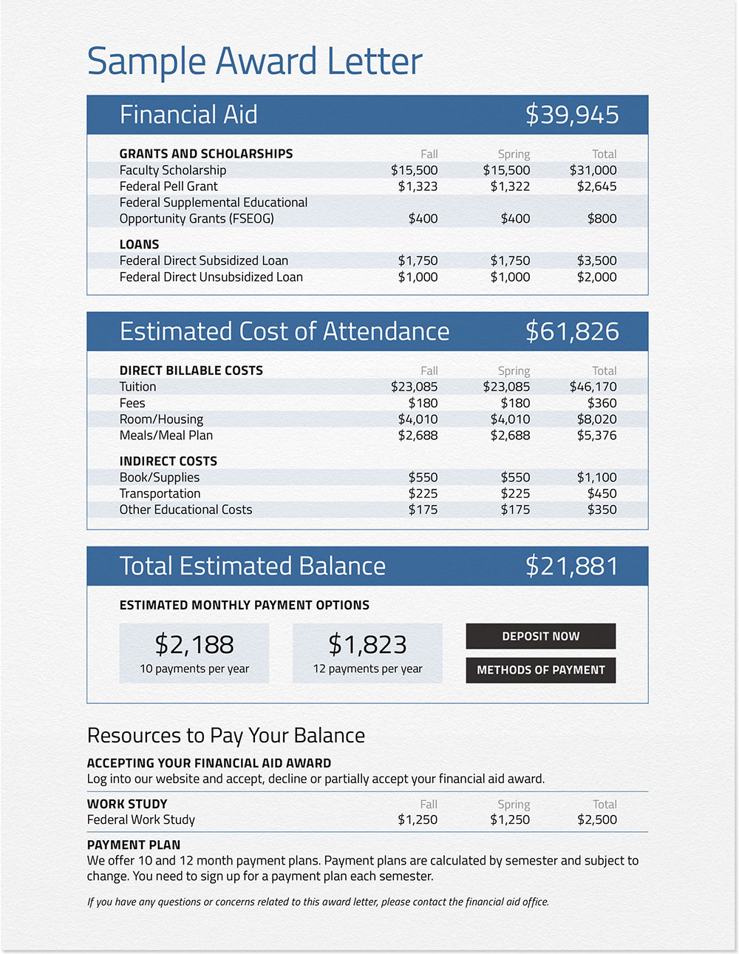
Sample Award Notification
Ways to Pay
Scholarships
Savings
529 Savings plans
Tuition Payment Plan through the school
Student earnings from work
Federal Student Loans
Federal Parent Loans
Home Equity Loans
Private/ Alternative Loans

Slide 64
Final Thoughts & Wrap Up

Slide 65
Financial Aid Made Simple
Look for FREE money first
Know your forms & specific deadlines
Fill out the FAFSA
Compare schools financial aid offers carefully
Be sure you have the money you need
5 Steps to Financial Aid
a Step 1 Step 2 Step 3 Step 4 Step 5
Notes:
Have you made an affordable choice of school?
Do you understand your actual costs?
Have you considered annual out of pocket costs beyond the first year?
Do you have a strategy for handling out of pocket costs?
Do you understand loan options and their limitations?

Slide 66

What Can You Do Now?
Apply for FSA ID Account
Visit College Websites
Talk about what is affordable
Use Net Price Calculators
Explore Scholarships

Slide 67

Review and consider all options. Sometimes the best fit is not the first school choice.
Notes:
Choosing a career and a school is a big decision. To choose the school and program that’s right for you, you’ll need to gather information. Of course you’ll be looking at the college’s academic rigor and whether you’ll qualify for admission. But there are other factors that could also affect your ability to be successful in completing your degree or program.
There are over 4000 schools in the United States. I’m sure there is more than 1 school that is a good academic and financial fit for you.

Slide 68

Use Your Resources
PHEAA.org
EducationPlanner.org
MySmartBorrowing.org
StudentAid.gov – The one-stop shop site for all financial aid information.
StudentAid.gov/FAFSA – Direct link to the FAFSA
PHEAA toll free: 800-692-7392
Federal Student Aid Info Center: 800-433-3243

Slide 69
QUESTIONS?
Jonathan Warner
jonathan.warner@pheaa.org

Slide 70
Scholarship Advice from High School Students
Keep trying and applying to as many as possible because the more you apply for, the more of a chance you have of getting one.
Its better to start as soon as possible, instead of rushing in your senior year.
Do not underestimate the power of small, local scholarships. Small
scholarships can add up.
Create a spreadsheet to keep track of all of the scholarships you find and plan to apply to.

